Slide 1
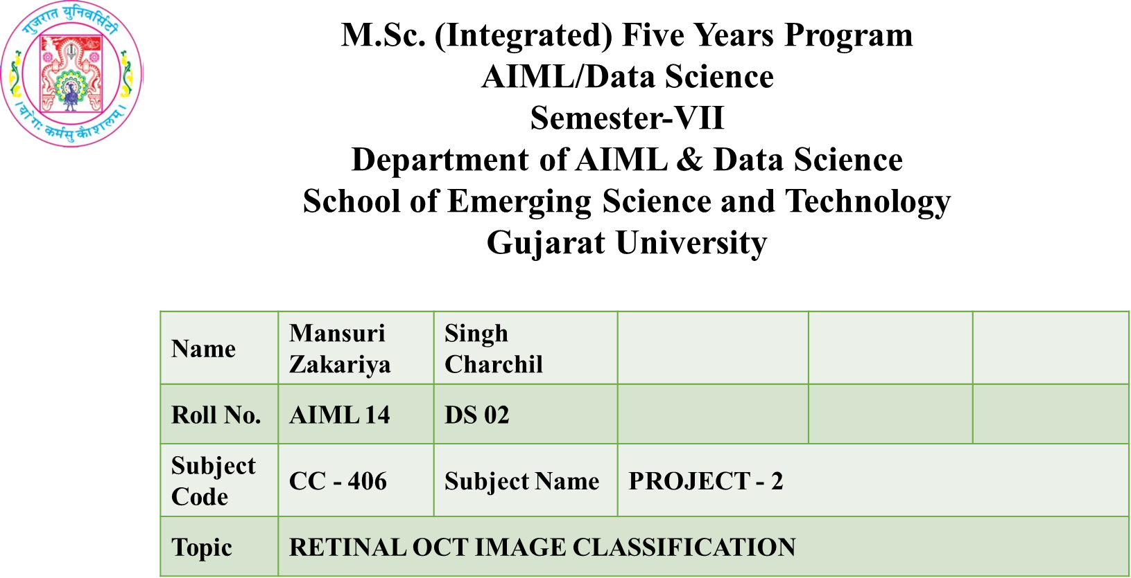

Slide 2

Retinal OCT image classification
Zakariya Mansuri – AI ML (14)
Charchil Singh – Data Science (2)

Slide 3

Introduction
•Retinal optical coherence tomography (OCT) is an imaging technique used to capture high-resolution cross sections of the retinas of living patients. Approximately 3 Crore OCT scans are performed each year, and the analysis and interpretation of these images takes up a significant amount of time.
•Optical Coherence Tomography (OCT) is a non-invasive diagnostic technique that renders an in vivo cross sectional view of the retina. OCT utilizes a concept known as inferometry to create a cross-sectional map of the retina that is accurate to within at least 10-15 microns
•This project is concentrated towards classifying the OCT images into 4 types
1)Normal
2)Choroidal neovascularization (CNV)
3)Diabetic macular edema(DME)
4)Drusen

Slide 4
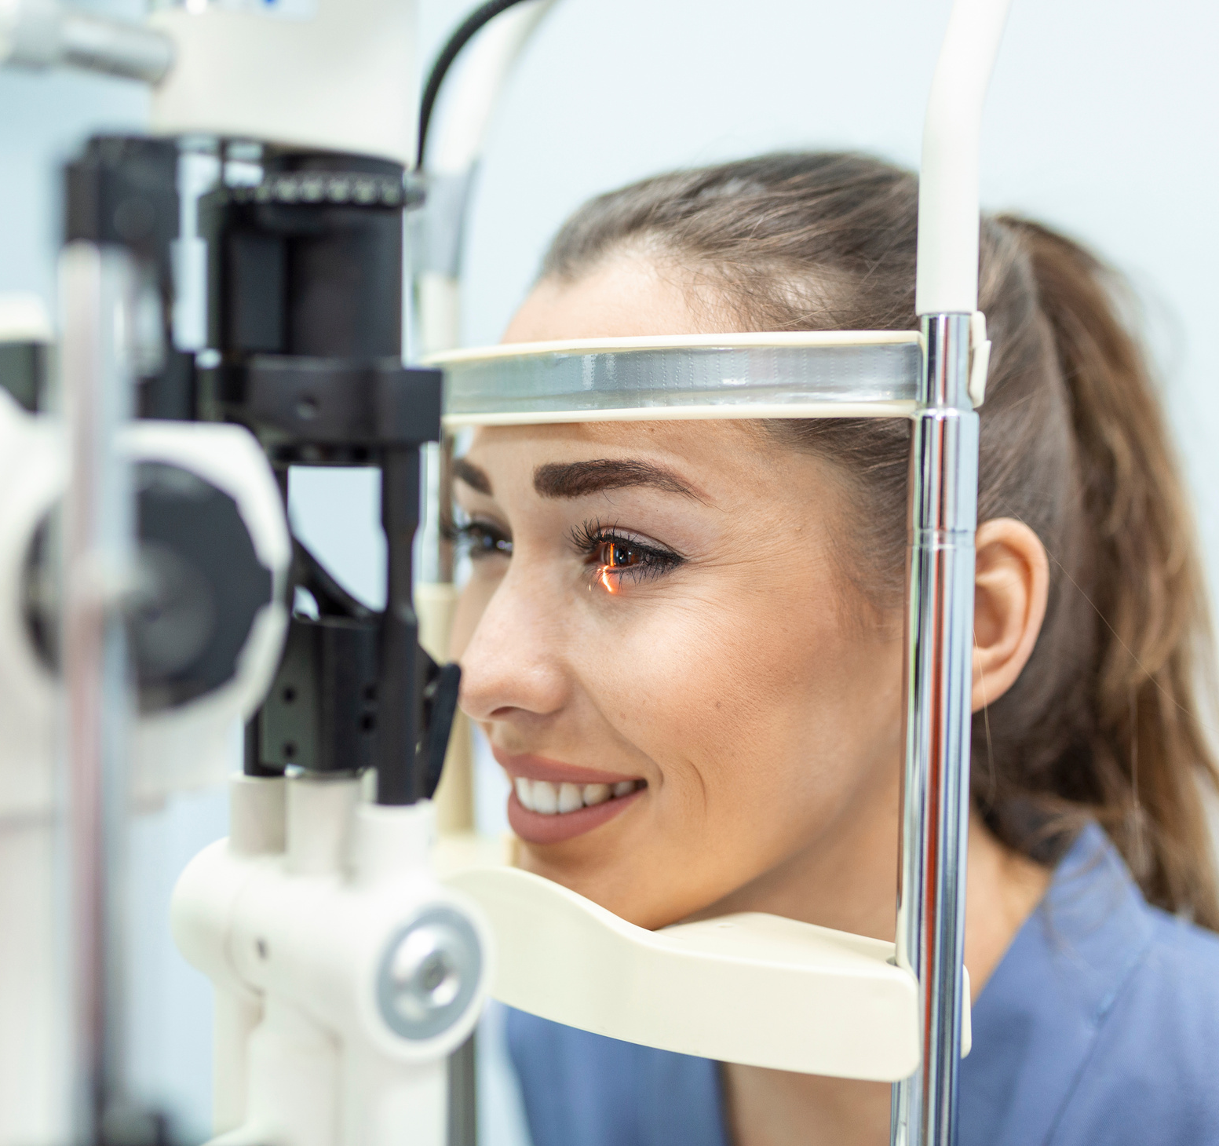
Optimal Coherence Topography
Optical coherence tomography (OCT) is a non-invasive imaging test. OCT uses light waves to take cross-section pictures of your retina.
With OCT, your ophthalmologist can see each of the retina’s distinctive layers. This allows your ophthalmologist to map and measure their thickness. These measurements help with diagnosis. They also provide treatment guidance for glaucoma and diseases of the retina. These retinal diseases include age-related macular degeneration (AMD) and diabetic eye disease.

Slide 5
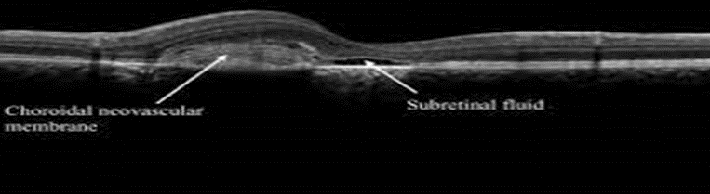
Choroidal Neovascularization
Neovascularization” means “new blood vessels.” These new, abnormal blood vessels originate in the choroid, a vessel-containing layer under the retina.
When the retinas of people with AMD produce too much vascular endothelial growth factor (VEGF), new blood vessels sprout from the choroid, then grow into the retina. The new vessels, unlike normal ones, are leaky, and they allow fluid from the blood, and sometimes even red blood cells, to enter the retina.
This fluid can immediately distort the vision because it forms a “blister” in the retina, which is normally flat. Over the course of days to months, this fluid can damage the retina, killing the light-sensing cells, called photoreceptors.
Symptoms of Choroidal Neovascularization
The symptoms of CNV include a distortion or waviness of central vision or a gray/black/void spot in the central vision. This should prompt a call to an ophthalmologist right away to get a priority emergency visit. The ophthalmologist can halt the growth and leakage of the blood vessels by injecting a drug blocking a protein called VEGF into the eye, but only if they can deliver the drug as soon as possible

Slide 6
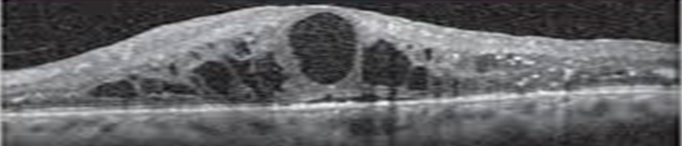
Diabetic Macular Edema
Diabetic macular edema (DME) is a complication of diabetes that affects the retina, the light-sensitive layer at the back of the eye. It occurs when excess fluid builds up in the macula, the part of the retina responsible for central vision. This can cause the macula to swell, leading to vision loss.
DME is a common cause of vision loss in people with diabetes, especially those who have had diabetes for a long time or who have poorly controlled blood sugar levels
There are effective treatments available for DME. Annual eye exams can detect any changes early. If you have DME, treatments can protect your eyesight and may reverse vision loss.
Symptoms of Diabetic Macular Edema
In its early stages, there may be no symptoms. If you have diabetes, it’s important to see an eye care doctor every year so they can examine your eyes for any changes. If there’s any sign of retinopathy or DME, early treatment can prevent or restore vision loss.
Make sure to tell your eye care doctor if you have any of the following symptoms:
blurry vision
seeing colors that look washed out
seeing more floaters in your vision
double vision

Slide 7
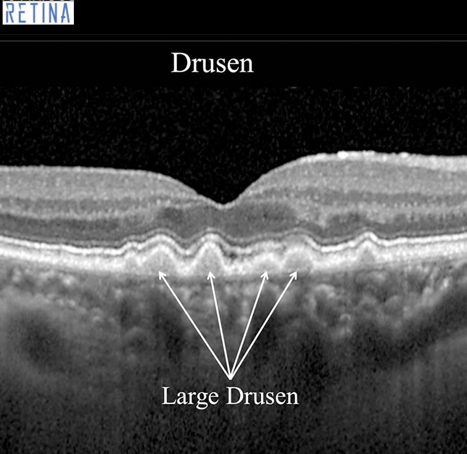

DRUSEN
Drusen are small, yellowish or white deposits that can form under the retina of the eye. They are composed of various substances, including fats and proteins, and are a common finding in the eyes of older individuals.
In most cases, drusen do not cause any symptoms and do not affect vision.
However, in some cases, drusen can be a sign of age-related macular degeneration (AMD), a condition that can lead to vision loss. If you have drusen and are experiencing vision loss or other eye symptoms, it is important to speak with an eye care professional for proper evaluation and treatment.

Slide 8

How does Deep learning helps?
Artificial intelligence (AI) has the potential to revolutionize disease diagnosis and management by performing classification difficult for human experts and by rapidly reviewing immense amounts of images. Despite its potential, clinical interpretability and feasible preparation of AI remains challenging.
The development of convolutional neural network layers has allowed for significant gains in the ability to classify images and detect objects in a picture . These are multiple processing layers to which image analysis filters, or convolutions, are applied. The abstracted representation of images within each layer is constructed by systematically convolving multiple filters across the image, producing a feature map that is used as input to the following layer
The traditional algorithmic approach to image analysis for classification previously relied on (1) handcrafted object segmentation, followed by (2) identification of each segmented object using statistical classifiers or shallow neural computational machine-learning classifiers designed specifically for each class of objects, and finally (3) classification of the image. Creating and refining multiple classifiers required many skilled people and much time and was computationally expensive
This architecture makes it possible to process images in the form of pixels as input and to give the desired tomography (OCT) images of the retina, but the algorithm was also tested in a cohort of pediatric chest radiographs to validate the generalizability of this technique across multiple imaging modalities.

Slide 9
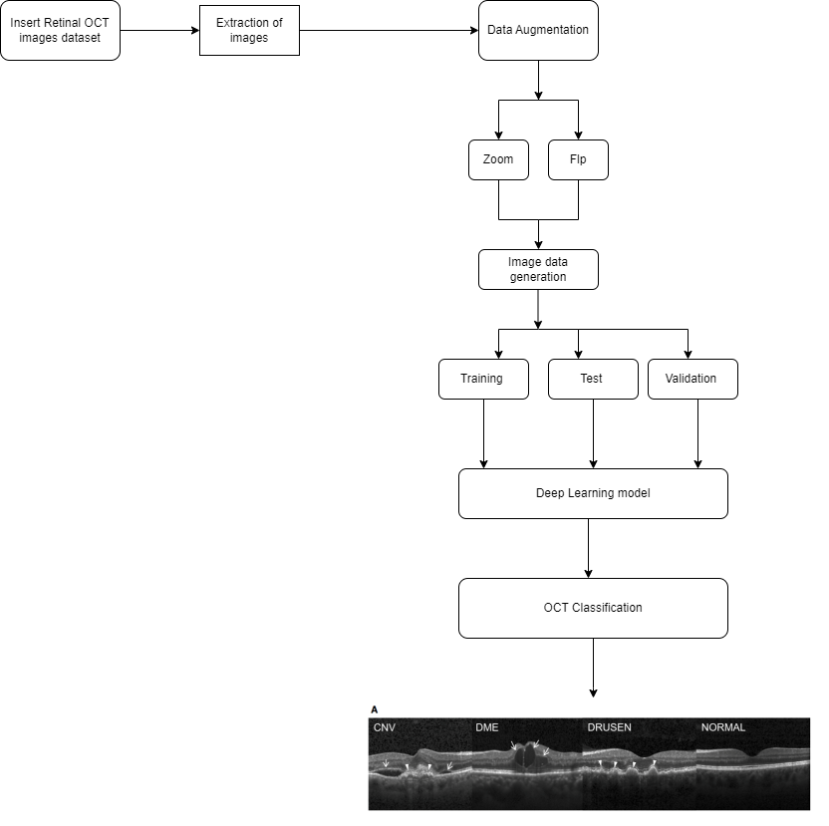

Workflow

Slide 10


Dataset
The dataset is organized into 3 folders (train, test, val) and contains subfolders for each image category (NORMAL,CNV,DME,DRUSEN). There are 84,495 X-Ray images (JPEG) and 4 categories (NORMAL,CNV,DME,DRUSEN).
Images are labeled as (disease)-(randomized patient ID)-(image number by this patient) and split into 4 directories: CNV, DME, DRUSEN, and NORMAL.
Optical coherence tomography (OCT) images (Spectralis OCT, Heidelberg Engineering, Germany) were selected from retrospective cohorts of adult patients from the Shiley Eye Institute of the University of California San Diego, the California Retinal Research Foundation, Medical Center Ophthalmology Associates, the Shanghai First People’s Hospital, and Beijing Tongren Eye Center between July 1, 2013 and March 1, 2017

Slide 11

Drusen
10.5%
Data Analysis
Distribution of Dataset
Normal
31.5%
DME
13.7%
•Here the data distribution is given
26,550 Normal images
37,450 CNV images
11,550 DME images
8,866 Drusen images
CNV
44.4%
Training Data
Test Data
Validation Data
Training data consist of 98.8% of the total dataset containing 83,484 images
Test data consist of 1.14% of the total dataset containing 968 images
Validation data consist of 0.06% of the total dataset containing 32 images

Slide 12
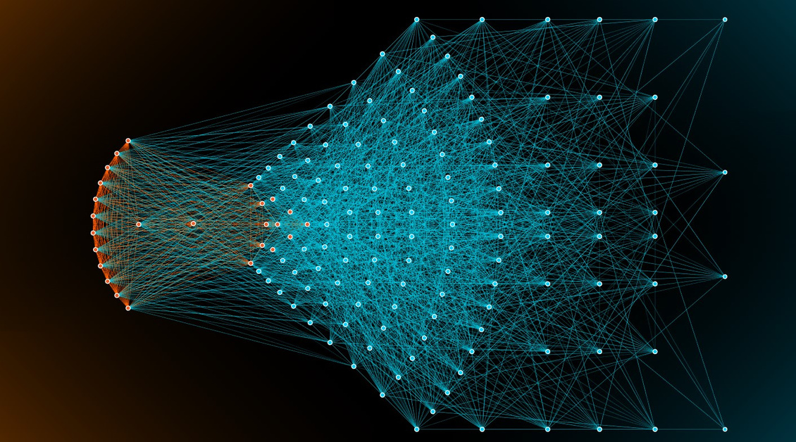
Deep Learning Model
Convolutional Neural Network
•The classification modeling is done by designing deep learning CNN architecture and transfer learning mechanism.
•A convolutional neural network (CNN ) is a network architecture for deep learningwhich learns directly from data, eliminating the need for manual feature extraction.
•CNNs are particularly useful for finding patterns in images to recognize objects, faces, and scenes. They can also be quite effective for classifying non-image data such as audio, time series, and signal data.

Slide 13


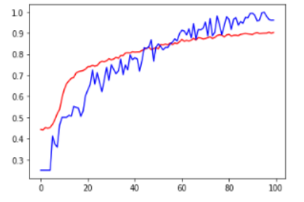
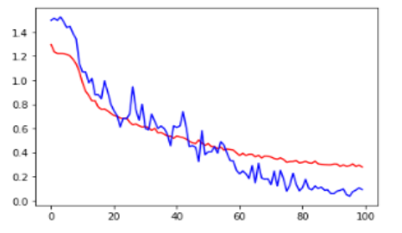
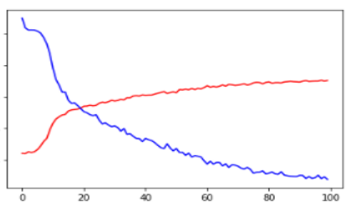
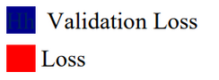

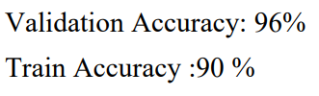

Results
Train accuracy vs Validation accuracy
Loss vs Validation
Accuracy vs Loss
Accuracy
Loss

Slide 14
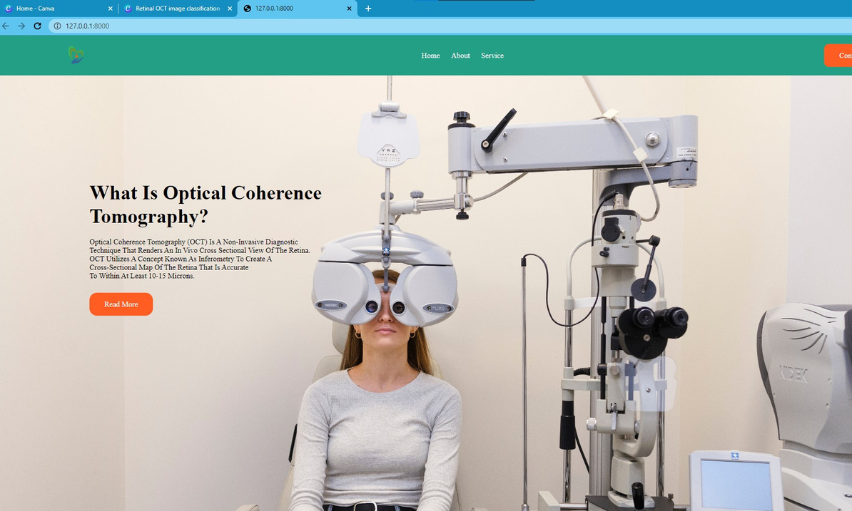

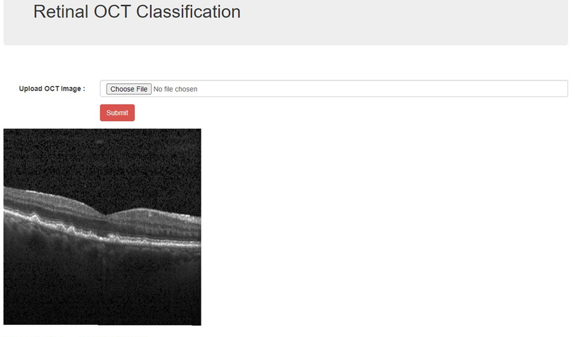
Web App & API
using Flask
Working Model with interactive options
Classification model
CNN based classification model which uses input as a image, send to the model and returns image with prediction .

Slide 15

Thank
You

